Slide 2
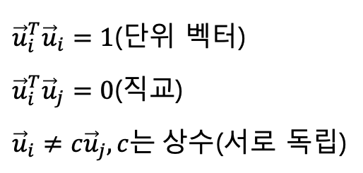
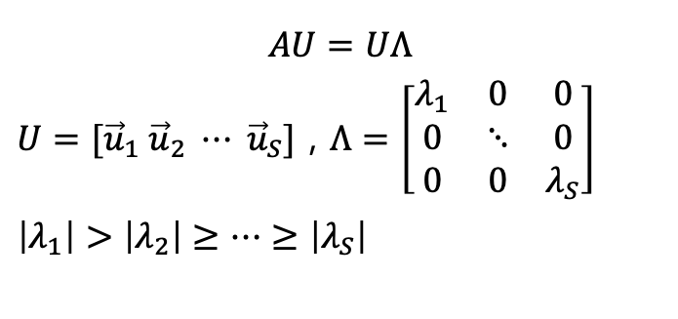
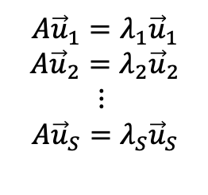
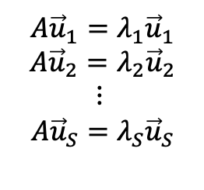
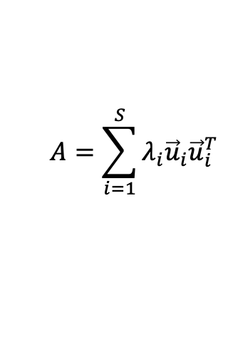
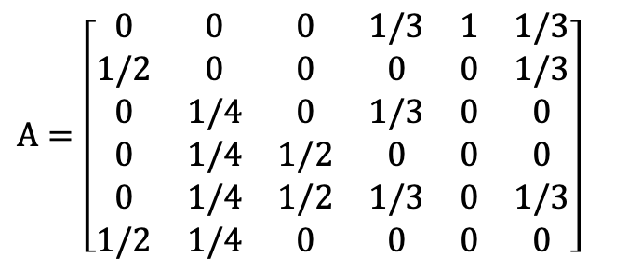
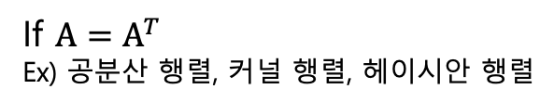

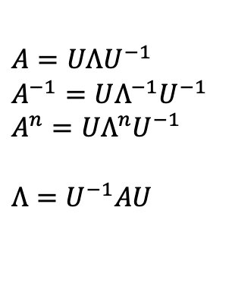
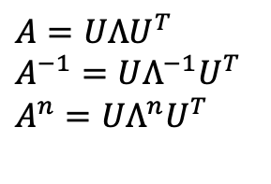
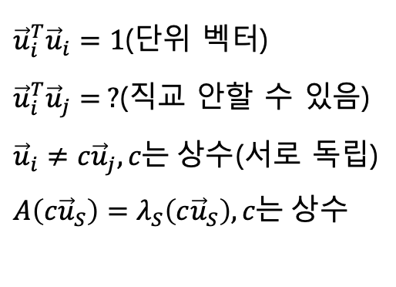
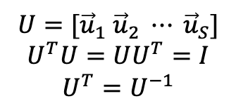
$A=\left[\begin{matrix}0 & 0 & 0 & 1/3 & 1 & 1/3 \\ 1/2 & 0 & 0 & 0 & 0 & 1/3 \\ 0 & 1/4 & 0 & 1/3 & 0 & 0 \\ 0 & 1/4 & 1/2 & 0 & 0 & 0 \\ 0 & 1/4 & 1/2 & 1/3 & 0 & 1/3 \\ 1/2 & 1/4 & 0 & 0 & 0 & 0\end{matrix}\right]$
If $A=A^{T}$
Ex) 공분산 행렬, 커널 행렬, 헤이시안 행렬
${\vec{u}}_{i}^{T}{\vec{u}}_{i}=1$(단위 벡터)
${\vec{u}}_{i}^{T}{\vec{u}}_{j}=0$(직교)
${\vec{u}}_{i}≠{c\vec{u}}_{j},c는 상수$(서로 독립)
$$A{\vec{u}}_{1}=λ_{1}{\vec{u}}_{1}$$
$$A{\vec{u}}_{2}=λ_{2}{\vec{u}}_{2}$$
$$⋮$$
$$A{\vec{u}}_{S}=λ_{S}{\vec{u}}_{S}$$
${\vec{u}}_{i}^{T}{\vec{u}}_{i}=1$(단위 벡터)
${\vec{u}}_{i}^{T}{\vec{u}}_{j}= ?$(직교 안할 수 있음)
${\vec{u}}_{i}≠{c\vec{u}}_{j},c는 상수$(서로 독립)
$A\left(c{\vec{u}}_{S}\right)=λ_{S}\left(c{\vec{u}}_{S}\right),c는 상수$
$$A{\vec{u}}_{1}=λ_{1}{\vec{u}}_{1}$$
$$A{\vec{u}}_{2}=λ_{2}{\vec{u}}_{2}$$
$$⋮$$
$$A{\vec{u}}_{S}=λ_{S}{\vec{u}}_{S}$$
$$U=[{\vec{u}}_{1} {\vec{u}}_{2} ⋯ {\vec{u}}_{S}]$$
$$U^{T}U=UU^{T}=I$$
$$U^{T}=U^{−1}$$
$A=UΛU^{−1}$
$A^{−1}=UΛ^{−1}U^{−1}$
$A^{n}=UΛ^{n}U^{−1}$
$Λ=U^{−1}AU$
$A=UΛU^{T}$
$A^{−1}=UΛ^{−1}U^{T}$
$A^{n}=UΛ^{n}U^{T}$
$$AU=UΛ$$
$U=[{\vec{u}}_{1} {\vec{u}}_{2} ⋯ {\vec{u}}_{S}]$ , $Λ=\left[\begin{matrix}λ_{1} & 0 & 0 \\ 0 & ⋱ & 0 \\ 0 & 0 & λ_{S}\end{matrix}\right]$
$\left|λ_{1}\right|>\left|λ_{2}\right|≥⋯≥\left|λ_{S}\right|$
$$Λ=U^{T}AU$$
$$A=\sum_{i=1}^{S}{λ_{i}{\vec{u}}_{i}{\vec{u}}_{i}^{T}}$$

Slide 3
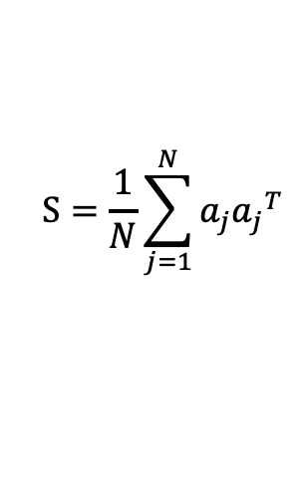
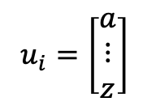

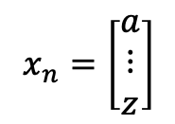
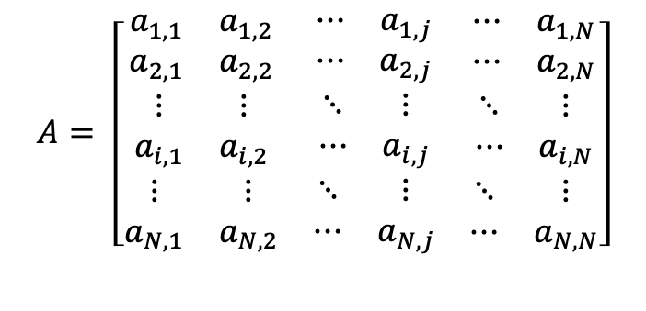
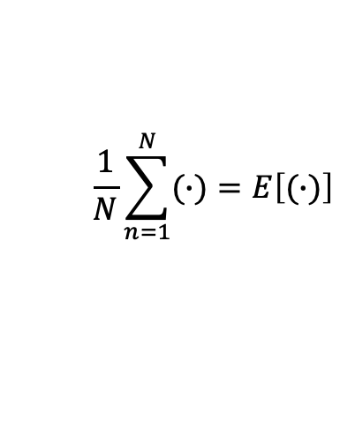
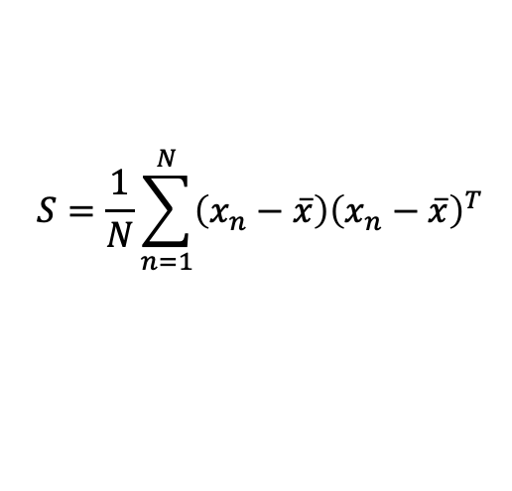

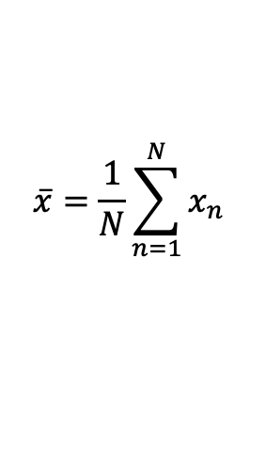
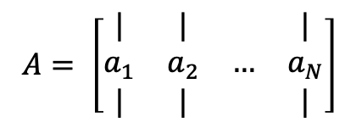
$$A= \left[\begin{matrix}\begin{matrix}a_{1,1} & a_{1,2} \\ a_{2,1} & a_{2,2}\end{matrix} & \begin{matrix}⋯ & a_{1,j} \\ ⋯ & a_{2,j}\end{matrix} & \begin{matrix}⋯ & a_{1,N} \\ ⋯ & a_{2,N}\end{matrix} \\ \begin{matrix}⋮ & ⋮ \\ a_{i,1} & a_{i,2}\end{matrix} & \begin{matrix}⋱ & ⋮ \\ ⋯ & a_{i,j}\end{matrix} & \begin{matrix}⋱ & ⋮ \\ ⋯ & a_{i,N}\end{matrix} \\ \begin{matrix}⋮ & ⋮ \\ a_{N,1} & a_{N,2}\end{matrix} & \begin{matrix}⋱ & ⋮ \\ ⋯ & a_{N,j}\end{matrix} & \begin{matrix}⋱ & ⋮ \\ ⋯ & a_{N,N}\end{matrix}\end{matrix}\right]$$
$$x_{n}=\left[\begin{matrix}a \\ ⋮ \\ z\end{matrix}\right]$$
$$u_{i}=\left[\begin{matrix}a \\ ⋮ \\ z\end{matrix}\right]$$
$$\overline{x}=\frac{1}{N}\sum_{n=1}^{N}{x_{n}}$$
$$A= \left[\begin{matrix}| & | & & | \\ a_{1} & a_{2} & … & a_{N} \\ | & | & & |\end{matrix}\right]$$
$$S=\frac{1}{N}\sum_{n=1}^{N}{\left(x_{n}−\overline{x}\right){\left(x_{n}−\overline{x}\right)}^{T}}$$
$$S=N^{−1}AA^{T}$$
$$S=\frac{1}{N}\sum_{j=1}^{N}{a_{j}{a_{j}}^{T}}$$
$$S=E\left[\left(x_{n}−\overline{x}\right){\left(x_{n}−\overline{x}\right)}^{T}\right]$$
$$\frac{1}{N}\sum_{n=1}^{N}{(∙)}=E\left[(∙)\right]$$

Slide 4
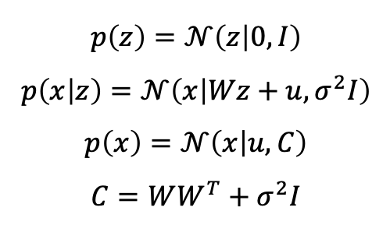

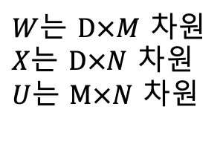


$D$는 데이터 차원
$M$은 줄이고 싶은 데이터 차원
$N$은 데이터 수
$$x=Wz+u+ε$$
$M<D$가 목적
$$p\left(z\right)=𝒩\left(z | 0, I\right)$$
$$p\left(x | z\right)=𝒩\left(x | Wz+u, σ^{2}I\right)$$
$$p\left(x\right)=𝒩\left(x | u, C\right)$$
$$C=WW^{T}+σ^{2}I$$
$W$는 $D×M$ 차원
$X$는 $D×N$ 차원
$U$는 $M×N$ 차원

Slide 5



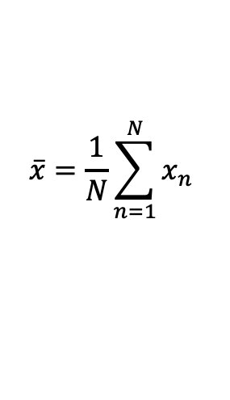

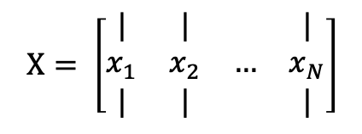
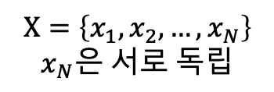
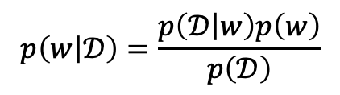
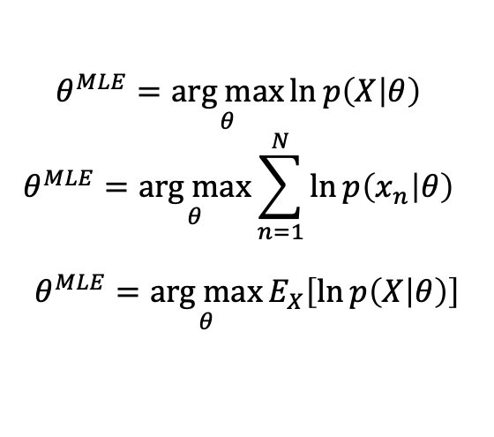

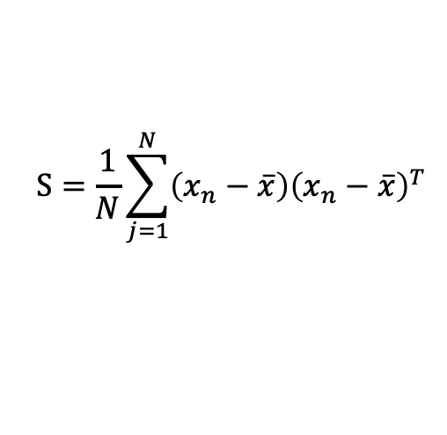
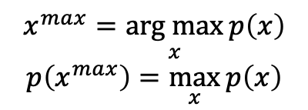

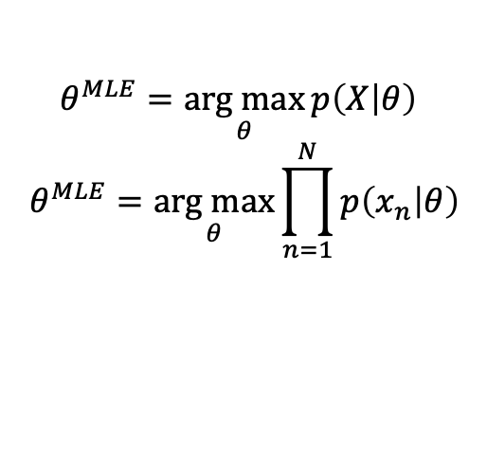
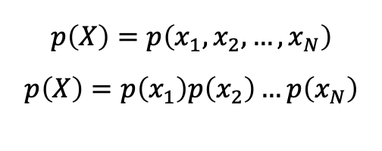

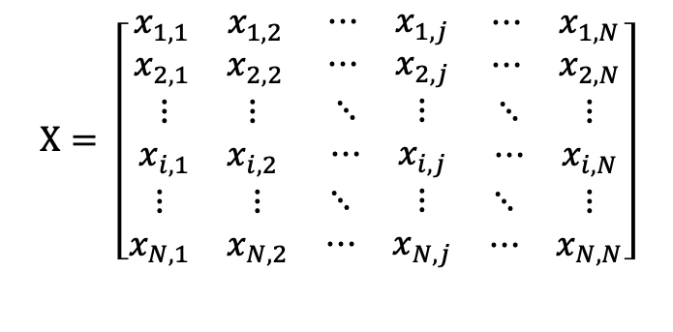
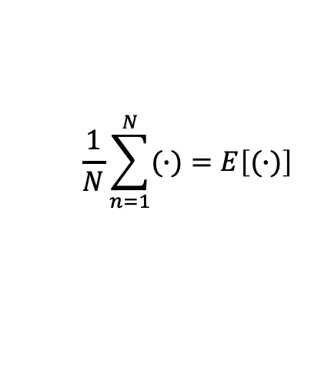

$$X= \left[\begin{matrix}\begin{matrix}x_{1,1} & x_{1,2} \\ x_{2,1} & x_{2,2}\end{matrix} & \begin{matrix}⋯ & x_{1,j} \\ ⋯ & x_{2,j}\end{matrix} & \begin{matrix}⋯ & x_{1,N} \\ ⋯ & x_{2,N}\end{matrix} \\ \begin{matrix}⋮ & ⋮ \\ x_{i,1} & x_{i,2}\end{matrix} & \begin{matrix}⋱ & ⋮ \\ ⋯ & x_{i,j}\end{matrix} & \begin{matrix}⋱ & ⋮ \\ ⋯ & x_{i,N}\end{matrix} \\ \begin{matrix}⋮ & ⋮ \\ x_{N,1} & x_{N,2}\end{matrix} & \begin{matrix}⋱ & ⋮ \\ ⋯ & x_{N,j}\end{matrix} & \begin{matrix}⋱ & ⋮ \\ ⋯ & x_{N,N}\end{matrix}\end{matrix}\right]$$
$$x^{max}=\underset{x}{arg max}{p\left(x\right)}$$
$$p\left(x^{max}\right)=\max_{x}{p\left(x\right)}$$
$$\frac{1}{N}\sum_{n=1}^{N}{(∙)}=E\left[(∙)\right]$$
$$\overline{x}=\frac{1}{N}\sum_{n=1}^{N}{x_{n}}$$
$$p\left(X\right)=p\left(x_{1},x_{2},…,x_{N}\right)$$
$$p\left(X\right)=p\left(x_{1}\right)p\left(x_{2}\right)…p\left(x_{N}\right)$$
$$X=\left\{x_{1},x_{2},…,x_{N}\right\}$$
$$x_{N}은 서로 독립$$
$$X= \left[\begin{matrix}| & | & & | \\ x_{1} & x_{2} & … & x_{N} \\ | & | & & |\end{matrix}\right]$$
$$p\left(X | θ\right)$$
$$θ는 모델 매개변수$$
$$θ^{MLE}=\underset{θ}{arg max}{\ln{p\left(X | θ\right)} }$$
$$θ^{MLE}=\underset{θ}{arg max}{\sum_{n=1}^{N}{\ln{p\left(x_{n} | θ\right)}} }$$
$$θ^{MLE}=\underset{θ}{arg max}{E_{X}\left[\ln{p\left(X | θ\right)}\right]}$$
$$S=N^{−1}\left(X−\overline{x}\right){\left(X−\overline{x}\right)}^{T}$$
$$θ^{MLE}=\underset{θ}{arg max}{p\left(X | θ\right) }$$
$$θ^{MLE}=\underset{θ}{arg max}{\prod_{n=1}^{N}{p\left(x_{n} | θ\right)}}$$
$$S=\frac{1}{N}\sum_{j=1}^{N}{\left(x_{n}−\overline{x}\right){\left(x_{n}−\overline{x}\right)}^{T}}$$
$$S=E\left[\left(x_{n}−\overline{x}\right){\left(x_{n}−\overline{x}\right)}^{T}\right]$$
$$p\left(w | 𝒟\right) posterior$$
$$p\left(w\right) :prior$$
$$p\left(w | 𝒟\right)=\frac{p\left(𝒟 | w\right)p\left(w\right)}{p\left(𝒟\right)}$$
$$𝒟는 데이터 집합$$
$$w는 모델 매개변수$$
$$p\left(𝒟 | w\right) :likelihood$$
Notes:
https://datascienceschool.net/view-notebook/864a2cc43df44531be32e3fa48769501/

Slide 6

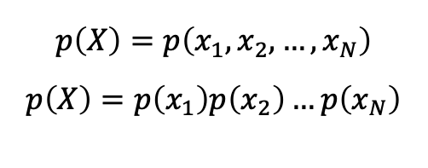


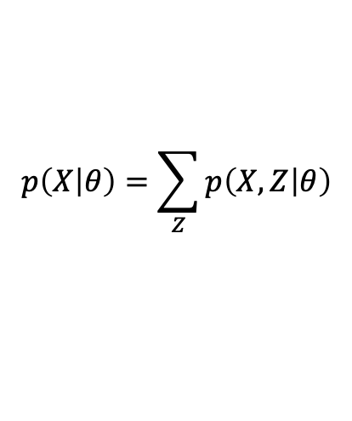
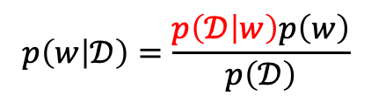
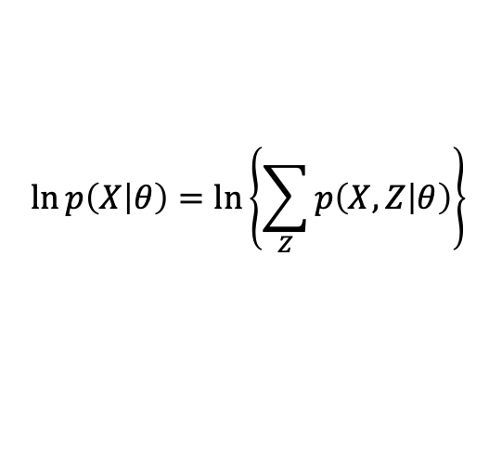
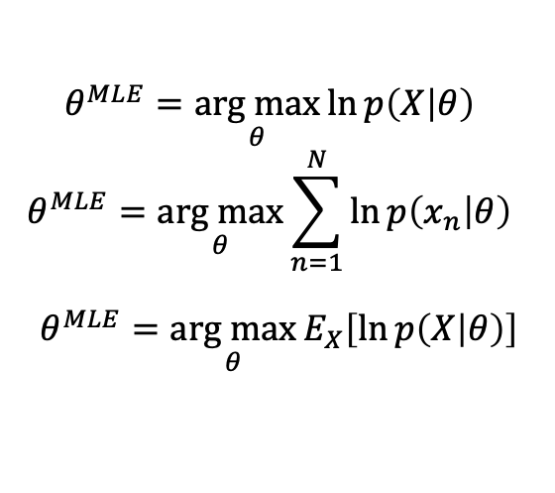
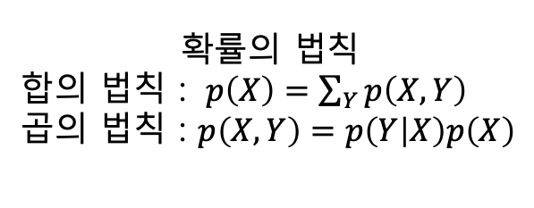



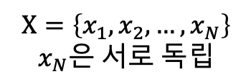
$$p\left(X\right)=p\left(x_{1},x_{2},…,x_{N}\right)$$
$$p\left(X\right)=p\left(x_{1}\right)p\left(x_{2}\right)…p\left(x_{N}\right)$$
$$X=\left\{x_{1},x_{2},…,x_{N}\right\}$$
$$x_{N}은 서로 독립$$
$$𝒟는 데이터 집합$$
$$w는 모델 매개변수$$
$$p\left(w | 𝒟\right) : posterior$$
$$p\left(w | 𝒟\right)=\frac{p\left(𝒟 | w\right)p\left(w\right)}{p\left(𝒟\right)}$$
$$p\left(w\right) :prior$$
$$p\left(𝒟 | w\right) :likelihood$$
$$p\left(X | θ\right)$$
$$θ는 모델 매개변수$$
$$θ^{MLE}=\underset{θ}{arg max}{\ln{p\left(X | θ\right)} }$$
$$θ^{MLE}=\underset{θ}{arg max}{\sum_{n=1}^{N}{\ln{p\left(x_{n} | θ\right)}} }$$
$$θ^{MLE}=\underset{θ}{arg max}{E_{X}\left[\ln{p\left(X | θ\right)}\right]}$$
$$p\left(X | θ\right)=\sum_{Z}{p\left(X,Z | θ\right)}$$
확률의 법칙
합의 법칙 : $p\left(X\right)=\sum_{Y}{p\left(X,Y\right)}$
곱의 법칙 : $p\left(X,Y\right)=p\left(Y | X\right)p\left(X\right)$
EM Algorithm
$$\ln{p\left(X | θ\right)=\ln\left\{\sum_{Z}{p\left(X,Z | θ\right)}\right\} }$$
Notes:
http://sanghyukchun.github.io/70/

Slide 7
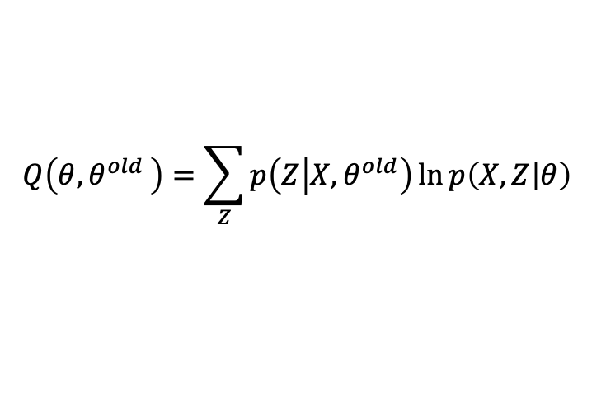


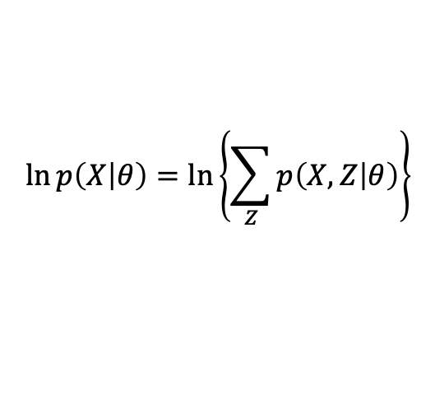

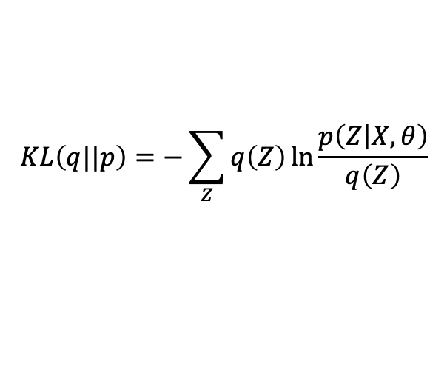
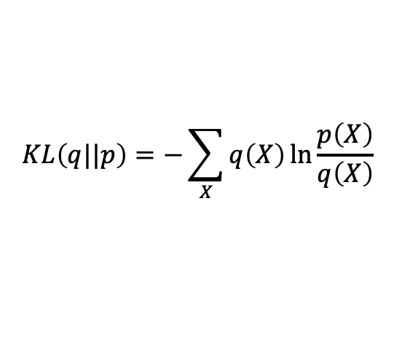
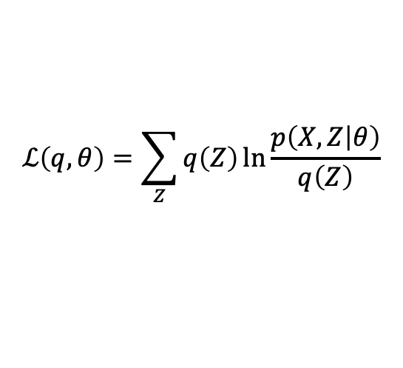

EM Algorithm
$$\ln{p\left(X | θ\right)}=\ln\left\{\sum_{Z}{p\left(X,Z | θ\right)}\right\}$$
$\ln{p\left(X | θ\right)}= ℒ\left(q,θ\right)+KL\left(q||p\right)$
$$q\left(Z\right)=p\left(Z | X,θ^{old}\right)$$
$$ℒ\left(q,θ\right)=\sum_{Z}{q\left(Z\right)\ln{\frac{p\left(X,Z | θ\right)}{q\left(Z\right)}}}$$
E-step
$$p\left(Z | X,θ^{old}\right)$$
M-step
$$θ^{new}=\underset{θ}{arg max}{Q\left(θ{,θ}^{old}\right) }$$
$$KL\left(q||p\right)=−\sum_{Z}{q\left(Z\right)\ln{\frac{p\left(Z | X,θ\right)}{q\left(Z\right)}}}$$
$$Q\left(θ{,θ}^{old}\right)=\sum_{Z}{p\left(Z | X,θ^{old}\right)\ln{p\left(X,Z | θ\right)}}$$
$$KL\left(q||p\right)=−\sum_{X}{q\left(X\right)\ln{\frac{p\left(X\right)}{q\left(X\right)}}}$$

Slide 8
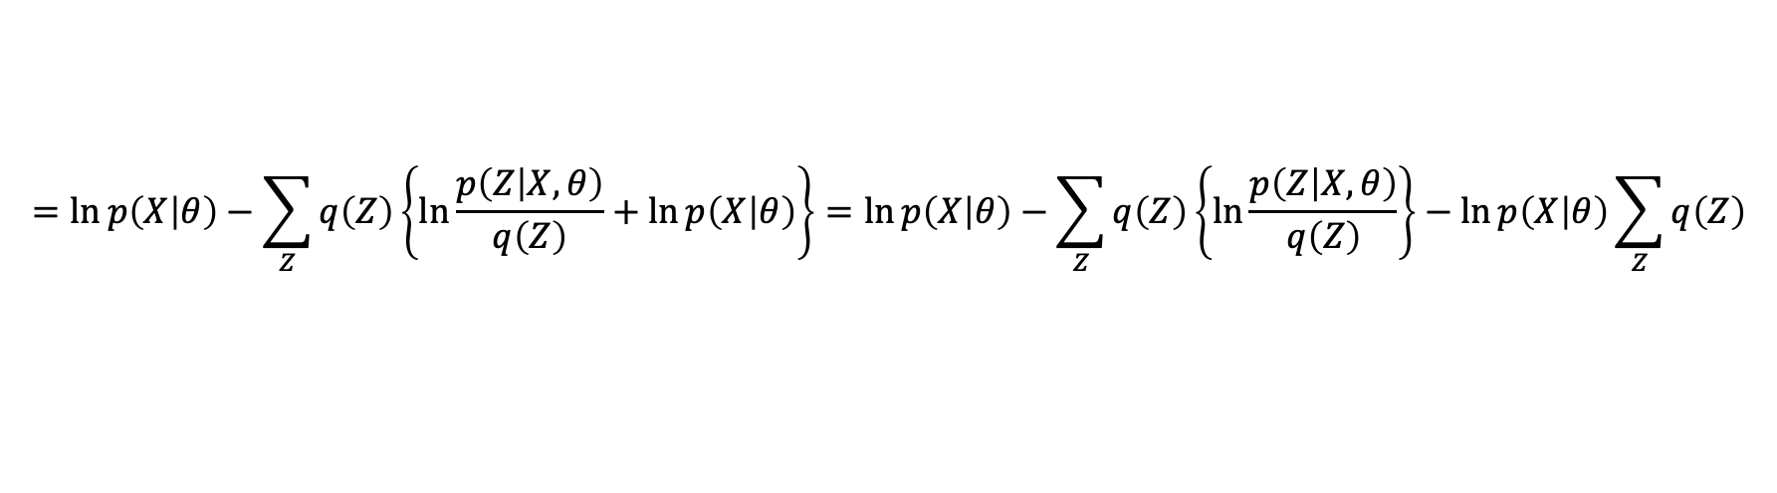
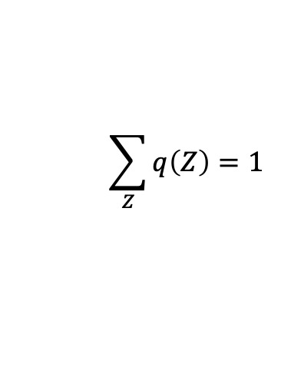
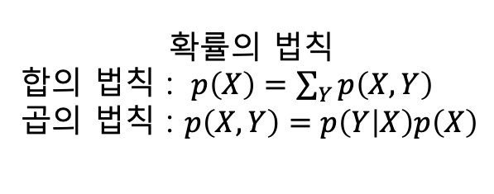
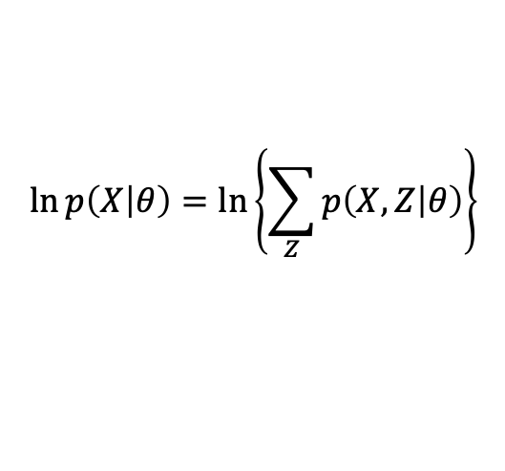
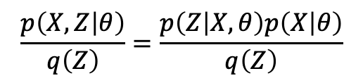
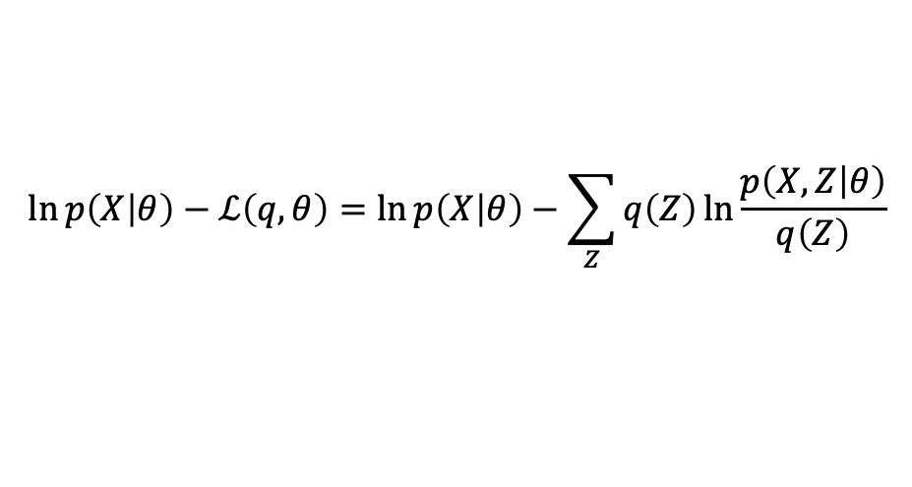


EM Algorithm 수식 유도
$$\ln{p\left(X | θ\right)}=\ln\left\{\sum_{Z}{p\left(X,Z | θ\right)}\right\}$$
$$\sum_{Z}{q\left(Z\right)}=1$$
$$\ln\left\{\sum_{Z}{p\left(X,Z | θ\right)}\right\}=\ln\left\{\sum_{Z}{q\left(Z\right)\frac{p\left(X,Z | θ\right)}{q\left(Z\right)}}\right\}≥\sum_{Z}{q\left(Z\right)\ln{\frac{p\left(X,Z | θ\right)}{q\left(Z\right)}}}=ℒ\left(q,θ\right)$$
확률의 법칙
합의 법칙 : $p\left(X\right)=\sum_{Y}{p\left(X,Y\right)}$
곱의 법칙 : $p\left(X,Y\right)=p\left(Y | X\right)p\left(X\right)$
$$\ln{p\left(X | θ\right)}−ℒ\left(q,θ\right)=\ln{p\left(X | θ\right)}−\sum_{Z}{q\left(Z\right)\ln{\frac{p\left(X,Z | θ\right)}{q\left(Z\right)}}}$$
$$\frac{p\left(X,Z | θ\right)}{q\left(Z\right)}=\frac{p\left(Z | X,θ\right)p\left(X | θ\right)}{q\left(Z\right)}$$
$$=\ln{p\left(X | θ\right)}−\sum_{Z}{q\left(Z\right)\left\{\ln{\frac{p\left(Z | X,θ\right)}{q\left(Z\right)}}+\ln{p\left(X | θ\right)}\right\}}=\ln{p\left(X | θ\right)}−\sum_{Z}{q\left(Z\right)\left\{\ln{\frac{p\left(Z | X,θ\right)}{q\left(Z\right)}}\right\}}−\ln{p\left(X | θ\right)}\sum_{Z}{q\left(Z\right)}$$
$$=−\sum_{Z}{q\left(Z\right)\ln{\frac{p\left(Z | X,θ\right)}{q\left(Z\right)}}}$$

Slide 9







EM Algorithm 수식 유도
$$\sum_{n=1}^{N}{\ln{p\left(x_{n} | θ\right)}} =\sum_{n=1}^{N}{\ln\left\{\sum_{i}{p\left(x_{n},z_{i} | θ\right)}\right\}}$$
$$\sum_{i}{q\left(z_{i}\right)}=1$$
$$\frac{p\left(x_{n},z_{i} | θ\right)}{q\left(z_{i}\right)}=\frac{p\left(z_{i} | x_{n},θ\right)p\left(x_{n} | θ\right)}{q\left(z_{i}\right)}$$
$$\sum_{n=1}^{N}{\ln\left\{\sum_{i}{p\left(x_{n},z_{i} | θ\right)}\right\}}=\sum_{n=1}^{N}{\ln\left\{\sum_{i}{q\left(z_{i}\right)\frac{p\left(x_{n},z_{i} | θ\right)}{q\left(z_{i}\right)}}\right\}}≥\sum_{n=1}^{N}{\sum_{i}{q\left(z_{i}\right)\ln{\frac{p\left(x_{n},z_{i} | θ\right)}{q\left(z_{i}\right)}}}}=\sum_{n=1}^{N}{ℒ\left(q,θ\right)}$$
$$\sum_{n=1}^{N}{\ln{p\left(x_{n} | θ\right)}}−\sum_{n=1}^{N}{ℒ\left(q,θ\right)}=\sum_{n=1}^{N}{\ln{p\left(x_{n} | θ\right)}}−\sum_{n=1}^{N}{\sum_{i}{q\left(z_{i}\right)\ln{\frac{p\left(x_{n},z_{i} | θ\right)}{q\left(z_{i}\right)}}}}$$
$$=\sum_{n=1}^{N}{\ln{p\left(x_{n} | θ\right)}}−\sum_{n=1}^{N}{\sum_{i}{q\left(z_{i}\right)\left\{\ln{\frac{p\left(z_{i} | x_{n},θ\right)}{q\left(z_{i}\right)}}+\ln{p\left(x_{n} | θ\right)}\right\}}}=\ln{p\left(X | θ\right)}−\sum_{Z}{q\left(Z\right)\left\{\ln{\frac{p\left(Z | X,θ\right)}{q\left(Z\right)}}\right\}}−\ln{p\left(X | θ\right)}\sum_{Z}{q\left(Z\right)}$$
$$=\sum_{n=1}^{N}{\ln{p\left(x_{n} | θ\right)}}−\sum_{n=1}^{N}{\sum_{i}{q\left(z_{i}\right)\left\{\ln{\frac{p\left(z_{i} | x_{n},θ\right)}{q\left(z_{i}\right)}}\right\}}}−\sum_{n=1}^{N}{\ln{p\left(x_{n} | θ\right)}}$$

Slide 10








EM Algorithm
$$\ln{p\left(X | θ\right)}=\ln\left\{\sum_{Z}{p\left(X,Z | θ\right)}\right\}$$
$\ln{p\left(X | θ\right)}= ℒ\left(q,θ\right)+KL\left(q||p\right)$
E-step
$$q\left(Z\right)=p\left(Z | X,θ^{old}\right)$$
$$KL\left(q||p\right)=−\sum_{Z}{q\left(Z\right)\ln{\frac{p\left(Z | X,θ\right)}{q\left(Z\right)}}}$$
$KL\left(q||p\right)$ 최소화
대입
$$ℒ\left(q,θ\right)=\sum_{Z}{q\left(Z\right)\ln{\frac{p\left(X,Z | θ\right)}{q\left(Z\right)}}}$$
M-step
$$θ^{new}=\underset{θ}{arg max}{Q\left(θ{,θ}^{old}\right) }$$
$$\sum_{Z}{p\left(Z | X,θ^{old}\right)\ln{\frac{p\left(X,Z | θ\right)}{p\left(Z | X,θ^{old}\right)}}}$$
$$Q\left(θ{,θ}^{old}\right)=\sum_{Z}{p\left(Z | X,θ^{old}\right)\ln{p\left(X,Z | θ\right)}}$$
계산
$$=\sum_{Z}{p\left(Z | X,θ^{old}\right)\ln{p\left(X,Z | θ\right)}}−\sum_{Z}{p\left(Z | X,θ^{old}\right)\ln{p\left(Z | X,θ^{old}\right)}}$$

Slide 11








$$θ^{MLE}=\underset{θ}{arg max}{\sum_{n=1}^{N}{\ln{p\left(x_{n} | θ\right)}} }$$
$$\sum_{n=1}^{N}{\ln\left\{\sum_{i}{p\left(x_{n},z_{i} | θ\right)}\right\}}≥\sum_{n=1}^{N}{\sum_{i}{q\left(z_{i}\right)\ln{\frac{p\left(x_{n},z_{i} | θ\right)}{q\left(z_{i}\right)}}}}$$
$$\sum_{n=1}^{N}{\ln{p\left(x_{n} | θ\right)}} =\sum_{n=1}^{N}{\ln\left\{\sum_{i}{p\left(x_{n},z_{i} | θ\right)}\right\}}=\sum_{n=1}^{N}{\sum_{i}{q\left(z_{i}\right)\ln{\frac{p\left(x_{n},z_{i} | θ\right)}{q\left(z_{i}\right)}}}} −\sum_{n=1}^{N}{\sum_{i}{q\left(z_{i}\right)\ln{\frac{p\left(z_{i} | x_{n},θ\right)}{q\left(z_{i}\right)}}}}$$
E step
$$q\left(z_{i}\right)=p\left(z_{i} | x_{n}{,θ}^{old}\right)$$
$$p\left(x_{n} | θ\right) 정의 어려움?$$
$$p\left(x_{n},z_{i} | θ\right) 정의 쉬움?$$
$$θ^{new}=\underset{θ}{arg max}{\sum_{n=1}^{N}{\sum_{i}{p\left(z_{i} | x_{n}{,θ}^{old}\right)\ln{p\left(x_{n},z_{i} | θ\right)}}}}$$
$$p\left(z_{i} | x_{n},θ\right) 정의 쉬움?$$
M step

Slide 12













${\vec{u}}_{i}^{T}{\vec{u}}_{i}=1$(단위 벡터)
${\vec{u}}_{i}^{T}{\vec{u}}_{j}=0$(직교)
${\vec{u}}_{i}≠{c\vec{u}}_{j},c는 상수$(서로 독립)
$$\frac{1}{N}\sum_{n=1}^{N}{(∙)}=E\left[(∙)\right]$$
$$\overline{x}=\frac{1}{N}\sum_{n=1}^{N}{x_{n}}$$
$$X= \left[\begin{matrix}\begin{matrix}x_{1,1} & x_{1,2} \\ x_{2,1} & x_{2,2}\end{matrix} & \begin{matrix}⋯ & x_{1,j} \\ ⋯ & x_{2,j}\end{matrix} & \begin{matrix}⋯ & x_{1,N} \\ ⋯ & x_{2,N}\end{matrix} \\ \begin{matrix}⋮ & ⋮ \\ x_{i,1} & x_{i,2}\end{matrix} & \begin{matrix}⋱ & ⋮ \\ ⋯ & x_{i,j}\end{matrix} & \begin{matrix}⋱ & ⋮ \\ ⋯ & x_{i,N}\end{matrix} \\ \begin{matrix}⋮ & ⋮ \\ x_{D,1} & x_{D,2}\end{matrix} & \begin{matrix}⋱ & ⋮ \\ ⋯ & x_{D,j}\end{matrix} & \begin{matrix}⋱ & ⋮ \\ ⋯ & x_{D,N}\end{matrix}\end{matrix}\right]$$
$$X=\left\{x_{1},x_{2},…,x_{N}\right\}$$
$$x_{N}은 서로 독립$$
$$S{\vec{u}}_{1}=λ_{1}{\vec{u}}_{1}$$
$$S{\vec{u}}_{2}=λ_{2}{\vec{u}}_{2}$$
$$⋮$$
$$S{\vec{u}}_{D}=λ_{D}{\vec{u}}_{D}$$
$$X= \left[\begin{matrix}| & | & & | \\ x_{1} & x_{2} & … & x_{N} \\ | & | & & |\end{matrix}\right]$$
$$U=[{\vec{u}}_{1} {\vec{u}}_{2} ⋯ {\vec{u}}_{D}]$$
$$U^{T}U=UU^{T}=I$$
$$U^{T}=U^{−1}$$
$D$는 데이터 차원
$M$은 줄이고 싶은 데이터 차원
$N$은 데이터 수
$$S=N^{−1}\left(X−\overline{x}\right){\left(X−\overline{x}\right)}^{T}$$
$S=UΛU^{T}$
$S^{−1}=UΛ^{−1}U^{T}$
$M<D$가 목적
$$S=\frac{1}{N}\sum_{j=1}^{N}{\left(x_{n}−\overline{x}\right){\left(x_{n}−\overline{x}\right)}^{T}}$$
$$Λ=U^{T}SU$$
$$S는 D×D행렬, 고유벡터 알고리즘 O\left(D^{3}\right)$$
$$S=E\left[\left(x_{n}−\overline{x}\right){\left(x_{n}−\overline{x}\right)}^{T}\right]$$
$$S=S^{T}$$
Ex) 공분산 행렬, 커널 행렬, 헤이시안 행렬
Notes:
https://datascienceschool.net/view-notebook/864a2cc43df44531be32e3fa48769501/

Slide 13













$$X=\left\{x_{1},x_{2},…,x_{N}\right\}$$
$$x_{N}은 서로 독립$$
$$\overline{x}=\frac{1}{N}\sum_{n=1}^{N}{x_{n}}$$
$$X= \left[\begin{matrix}\begin{matrix}x_{1,1} & x_{1,2} \\ x_{2,1} & x_{2,2}\end{matrix} & \begin{matrix}⋯ & x_{1,j} \\ ⋯ & x_{2,j}\end{matrix} & \begin{matrix}⋯ & x_{1,N} \\ ⋯ & x_{2,N}\end{matrix} \\ \begin{matrix}⋮ & ⋮ \\ x_{i,1} & x_{i,2}\end{matrix} & \begin{matrix}⋱ & ⋮ \\ ⋯ & x_{i,j}\end{matrix} & \begin{matrix}⋱ & ⋮ \\ ⋯ & x_{i,N}\end{matrix} \\ \begin{matrix}⋮ & ⋮ \\ x_{D,1} & x_{D,2}\end{matrix} & \begin{matrix}⋱ & ⋮ \\ ⋯ & x_{D,j}\end{matrix} & \begin{matrix}⋱ & ⋮ \\ ⋯ & x_{D,N}\end{matrix}\end{matrix}\right]$$
$$SU=UΛ$$
$U=[{\vec{u}}_{1} {\vec{u}}_{2} ⋯ {\vec{u}}_{D}]$ , $Λ=\left[\begin{matrix}λ_{1} & 0 & 0 \\ 0 & ⋱ & 0 \\ 0 & 0 & λ_{D}\end{matrix}\right]$
$\left|λ_{1}\right|>\left|λ_{2}\right|≥⋯≥\left|λ_{D}\right|$
$D$는 데이터 차원
$M$은 줄이고 싶은 데이터 차원
$N$은 데이터 수
$$X= \left[\begin{matrix}| & | & & | \\ x_{1} & x_{2} & … & x_{N} \\ | & | & & |\end{matrix}\right]$$
$M<D$가 목적
$$S는 D×D행렬, 고유벡터 알고리즘 O\left(D^{3}\right)$$
$${\vec{u}}_{1}는D×1벡터,$$
$$S=N^{−1}\left(X−\overline{x}\right){\left(X−\overline{x}\right)}^{T},O\left({ND}^{2}\right)$$
$$N^{−1}\left(X−\overline{x}\right){\left(X−\overline{x}\right)}^{T}U=UΛ$$
$$S=\frac{1}{N}\sum_{j=1}^{N}{\left(x_{n}−\overline{x}\right){\left(x_{n}−\overline{x}\right)}^{T}}$$
$$S{\vec{u}}_{1}=λ_{1}{\vec{u}}_{1}$$
$$N^{−1}\left(X−\overline{x}\right){\left(X−\overline{x}\right)}^{T}U=UΛ$$
$$N^{−1}\left(X−\overline{x}\right){\left(X−\overline{x}\right)}^{T}{\vec{u}}_{1}=λ_{1}{\vec{u}}_{1}$$
$$S=S^{T}$$
Ex) 공분산 행렬, 커널 행렬, 헤이시안 행렬
$$Y={\left(X−\overline{x}\right)}^{T}U$$
$$N^{−1}{\left(X−\overline{x}\right)}^{T}\left(X−\overline{x}\right)Y=YΛ$$

Slide 14










$$X= \left[\begin{matrix}\begin{matrix}x_{1,1} & x_{1,2} \\ x_{2,1} & x_{2,2}\end{matrix} & \begin{matrix}⋯ & x_{1,j} \\ ⋯ & x_{2,j}\end{matrix} & \begin{matrix}⋯ & x_{1,N} \\ ⋯ & x_{2,N}\end{matrix} \\ \begin{matrix}⋮ & ⋮ \\ x_{i,1} & x_{i,2}\end{matrix} & \begin{matrix}⋱ & ⋮ \\ ⋯ & x_{i,j}\end{matrix} & \begin{matrix}⋱ & ⋮ \\ ⋯ & x_{i,N}\end{matrix} \\ \begin{matrix}⋮ & ⋮ \\ x_{D,1} & x_{D,2}\end{matrix} & \begin{matrix}⋱ & ⋮ \\ ⋯ & x_{D,j}\end{matrix} & \begin{matrix}⋱ & ⋮ \\ ⋯ & x_{D,N}\end{matrix}\end{matrix}\right]$$
$$N^{−1}\left(X−\overline{x}\right){\left(X−\overline{x}\right)}^{T}U=UΛ$$
$$N^{−1}{\left(X−\overline{x}\right)}^{T}\left(X−\overline{x}\right){\left(X−\overline{x}\right)}^{T}U={\left(X−\overline{x}\right)}^{T}UΛ$$
$$Y={\left(X−\overline{x}\right)}^{T}U$$
$$X= \left[\begin{matrix}| & | & & | \\ x_{1} & x_{2} & … & x_{N} \\ | & | & & |\end{matrix}\right]$$
$$N^{−1}{\left(X−\overline{x}\right)}^{T}\left(X−\overline{x}\right)Y=YΛ$$
$$N^{−1}{\left(X−\overline{x}\right)\left(X−\overline{x}\right)}^{T}\left(X−\overline{x}\right)Y=\left(X−\overline{x}\right)YΛ$$
$$S=N^{−1}\left(X−\overline{x}\right){\left(X−\overline{x}\right)}^{T}$$
$$U=\left(X−\overline{x}\right)Y$$
$$Y= \left[\begin{matrix}\begin{matrix}y_{1,1} & y_{1,2} \\ y_{2,1} & y_{2,2}\end{matrix} & \begin{matrix}⋯ & y_{1,j} \\ ⋯ & y_{2,j}\end{matrix} & \begin{matrix}⋯ & y_{1,D} \\ ⋯ & y_{2,D}\end{matrix} \\ \begin{matrix}⋮ & ⋮ \\ y_{i,1} & y_{i,2}\end{matrix} & \begin{matrix}⋱ & ⋮ \\ ⋯ & y_{i,j}\end{matrix} & \begin{matrix}⋱ & ⋮ \\ ⋯ & y_{i,D}\end{matrix} \\ \begin{matrix}⋮ & ⋮ \\ y_{N,1} & y_{N,2}\end{matrix} & \begin{matrix}⋱ & ⋮ \\ ⋯ & y_{N,j}\end{matrix} & \begin{matrix}⋱ & ⋮ \\ ⋯ & y_{N,D}\end{matrix}\end{matrix}\right]$$
$$YU^{T}={\left(X−\overline{x}\right)}^{T}$$
$$UY^{T}=\left(X−\overline{x}\right)$$
$$X=UY^{T}+\overline{x}$$

Slide 15

















$$\sum_{n=1}^{N}{x_{n}=\overline{x}=0} 가정$$
$$\sum_{n=1}^{N}{φ\left(x_{n}\right)=0} 가정$$
${\vec{u}}_{i}^{T}{\vec{u}}_{i}=1$(단위 벡터)
${\vec{u}}_{i}^{T}{\vec{u}}_{j}=0$(직교)
${\vec{u}}_{i}≠{c\vec{u}}_{j},c는 상수$(서로 독립)
$$S=\frac{1}{N}\sum_{n=1}^{N}{x_{n}{x_{n}}^{T}}$$
$$C=\frac{1}{N}\sum_{n=1}^{N}{φ\left(x_{n}\right){φ\left(x_{n}\right)}^{T}}$$
$C$는 $?×?$ 차원
$$S{\vec{u}}_{i}=λ_{i}{\vec{u}}_{i}$$
$${\vec{v}}_{i}는?×1벡터$$
$$C{\vec{v}}_{i}=λ_{i}{\vec{v}}_{i}$$
$$\frac{1}{N}\sum_{n=1}^{N}{x_{n}{x_{n}}^{T}}{\vec{u}}_{i}=λ_{i}{\vec{u}}_{i}$$
$S$는 $D×D$ 차원
$$\frac{1}{N}\sum_{n=1}^{N}{φ\left(x_{n}\right){φ\left(x_{n}\right)}^{T}}{\vec{v}}_{i}=λ_{i}{\vec{v}}_{i}$$
$$x_{n}=\sum_{i=1}^{D}{α_{ni}{\vec{u}}_{i}}$$
$${\vec{v}}_{i}=\sum_{m=1}^{N}{a_{im}φ\left(x_{m}\right)}$$
$$y_{i}\left(x\right)=x_{n}^{T}{\vec{u}}_{i}$$
$$x_{n}=\sum_{i=1}^{D}{\left(x_{n}^{T}{\vec{u}}_{i}\right){\vec{u}}_{i}}$$
$$\frac{1}{N}\sum_{n=1}^{N}{φ\left(x_{n}\right){φ\left(x_{n}\right)}^{T}}\sum_{m=1}^{N}{a_{im}φ\left(x_{m}\right)}=λ_{i}\sum_{m=1}^{N}{a_{im}φ\left(x_{m}\right)}$$

Slide 16










$$\sum_{n=1}^{N}{φ\left(x_{n}\right)=0} 가정$$
$${φ\left(x_{l}\right)}^{T}$$
$$\frac{1}{N}{φ\left(x_{l}\right)}^{T}\sum_{n=1}^{N}{φ\left(x_{n}\right){φ\left(x_{n}\right)}^{T}}\sum_{m=1}^{N}{a_{im}φ\left(x_{m}\right)}=λ_{i}{φ\left(x_{l}\right)}^{T}\sum_{m=1}^{N}{a_{im}φ\left(x_{m}\right)}$$
$$C=\frac{1}{N}\sum_{n=1}^{N}{φ\left(x_{n}\right){φ\left(x_{n}\right)}^{T}}$$
$$C{\vec{v}}_{i}=λ_{i}{\vec{v}}_{i}$$
$$=\frac{1}{N}\sum_{n=1}^{N}{{φ\left(x_{l}\right)}^{T}φ\left(x_{n}\right)}\sum_{m=1}^{N}{a_{im}{φ\left(x_{l}\right)}^{T}φ\left(x_{m}\right)}=λ_{i}\sum_{m=1}^{N}{a_{im}{φ\left(x_{l}\right)}^{T}φ\left(x_{m}\right)}$$
$$\frac{1}{N}\sum_{n=1}^{N}{φ\left(x_{n}\right){φ\left(x_{n}\right)}^{T}}{\vec{v}}_{i}=λ_{i}{\vec{v}}_{i}$$
$$k\left(x_{a},x_{b}\right)={φ\left(x_{a}\right)}^{T}φ\left(x_{b}\right)={φ\left(x_{b}\right)}^{T}φ\left(x_{a}\right)=k\left(x_{b},x_{a}\right)$$
$${\vec{v}}_{i}=\sum_{m=1}^{N}{a_{im}φ\left(x_{m}\right)}$$
$$=\frac{1}{N}\sum_{n=1}^{N}{k\left(x_{l},x_{n}\right)}\sum_{m=1}^{N}{a_{im}k\left(x_{l},x_{m}\right)}=λ_{i}\sum_{m=1}^{N}{a_{im}k\left(x_{l},x_{m}\right)}$$
$$\frac{1}{N}\sum_{n=1}^{N}{φ\left(x_{n}\right){φ\left(x_{n}\right)}^{T}}\sum_{m=1}^{N}{a_{im}φ\left(x_{m}\right)}=λ_{i}\sum_{m=1}^{N}{a_{im}φ\left(x_{m}\right)}$$

Slide 17











$$=\frac{1}{N}\sum_{n=1}^{N}{k\left(x_{l},x_{n}\right)}\sum_{m=1}^{N}{a_{im}k\left(x_{l},x_{m}\right)}=λ_{i}\sum_{m=1}^{N}{a_{im}k\left(x_{l},x_{m}\right)}$$
$K$는 $N×N$ 차원
$C$는 $?×?$ 차원
$${\vec{v}}_{i}는?×1벡터$$
$$K=\left[\begin{matrix}k\left(x_{1},x_{1}\right) & k\left(x_{1},x_{2}\right) & ⋯ & k\left(x_{1},x_{N}\right) \\ k\left(x_{2},x_{1}\right) & k\left(x_{2},x_{2}\right) & ⋯ & k\left(x_{2},x_{N}\right) \\ ⋮ & ⋮ & ⋱ & ⋮ \\ k\left(x_{N},x_{1}\right) & k\left(x_{N},x_{2}\right) & ⋯ & k\left(x_{N},x_{N}\right)\end{matrix}\right]$$
$${\vec{a}}_{i}=\left[\begin{aligned}\begin{matrix}a_{i1} \\ a_{i2} \\ ⋮\end{matrix} \\ a_{iN}\end{aligned}\right]$$
$$K^{2}{\vec{a}}_{i}=λ_{i}NK{\vec{a}}_{i}$$
$$K{\vec{a}}_{i}=λ_{i}N{\vec{a}}_{i}$$
$${\vec{v}}_{i}=\sum_{m=1}^{N}{a_{im}φ\left(x_{m}\right)}$$
$$K{\vec{a}}_{i}=λ_{i}N{\vec{a}}_{i}$$
$$1={\vec{v}}_{i}^{T}{\vec{v}}_{i}=\sum_{m=1}^{N}{\sum_{n=1}^{N}{a_{im}a_{in}{φ\left(x_{m}\right)}^{T}φ\left(x_{n}\right)}}={\vec{a}}_{i}^{T}K{\vec{a}}_{i}={λ_{i}N\vec{a}}_{i}^{T}{\vec{a}}_{i}$$
$$1={λ_{i}N\vec{a}}_{i}^{T}{\vec{a}}_{i}$$

Slide 18














$$\sum_{n=1}^{N}{φ\left(x_{n}\right)=0} 가정$$
$$K=\left[\begin{matrix}k\left(x_{1},x_{1}\right) & k\left(x_{1},x_{2}\right) & ⋯ & k\left(x_{1},x_{N}\right) \\ k\left(x_{2},x_{1}\right) & k\left(x_{2},x_{2}\right) & ⋯ & k\left(x_{2},x_{N}\right) \\ ⋮ & ⋮ & ⋱ & ⋮ \\ k\left(x_{N},x_{1}\right) & k\left(x_{N},x_{2}\right) & ⋯ & k\left(x_{N},x_{N}\right)\end{matrix}\right]$$
$K$는 $N×N$ 차원
$${\vec{a}}_{i}=\left[\begin{aligned}\begin{matrix}a_{i1} \\ a_{i2} \\ ⋮\end{matrix} \\ a_{iN}\end{aligned}\right]$$
$$C=\frac{1}{N}\sum_{n=1}^{N}{φ\left(x_{n}\right){φ\left(x_{n}\right)}^{T}}$$
$C$는 $?×?$ 차원
$$K\left(x_{n}\right)=\left[\begin{aligned}\begin{matrix}k\left(x_{n},x_{1}\right) \\ k\left(x_{n},x_{2}\right) \\ ⋮\end{matrix} \\ k\left(x_{n},x_{N}\right)\end{aligned}\right]$$
$${\vec{v}}_{i}는?×1벡터$$
$$C{\vec{v}}_{i}=λ_{i}{\vec{v}}_{i}$$
$${\vec{a}}_{i}는N×1벡터$$
$$\frac{1}{N}\sum_{n=1}^{N}{φ\left(x_{n}\right){φ\left(x_{n}\right)}^{T}}{\vec{v}}_{i}=λ_{i}{\vec{v}}_{i}$$
$$y_{i}\left(x\right)={φ\left(x\right)}^{T}{\vec{v}}_{i}=\sum_{n=1}^{N}{a_{in}{φ\left(x\right)}^{T}φ\left(x_{n}\right)}=\sum_{n=1}^{N}{a_{in}k\left(x,x_{n}\right)}$$
$${\vec{v}}_{i}=\sum_{m=1}^{N}{a_{im}φ\left(x_{m}\right)}$$
$$y_{i}\left(x_{n}\right)={φ\left(x_{n}\right)}^{T}{\vec{v}}_{i}=\sum_{m=1}^{N}{a_{im}{φ\left(x_{n}\right)}^{T}φ\left(x_{m}\right)}=\sum_{m=1}^{N}{a_{im}k\left(x_{n},x_{m}\right)}$$
$$K{\vec{a}}_{i}=λ_{i}N{\vec{a}}_{i}$$
$${={K\left(x_{n}\right)}^{T}\vec{a}}_{i}$$

Slide 19













$$\sum_{n=1}^{N}{x_{n}=\overline{x}=0} 가정$$
$$\sum_{n=1}^{N}{φ\left(x_{n}\right)=0} 가정$$
$$K=\left[\begin{matrix}k\left(x_{1},x_{1}\right) & k\left(x_{1},x_{2}\right) & ⋯ & k\left(x_{1},x_{N}\right) \\ k\left(x_{2},x_{1}\right) & k\left(x_{2},x_{2}\right) & ⋯ & k\left(x_{2},x_{N}\right) \\ ⋮ & ⋮ & ⋱ & ⋮ \\ k\left(x_{N},x_{1}\right) & k\left(x_{N},x_{2}\right) & ⋯ & k\left(x_{N},x_{N}\right)\end{matrix}\right]$$
$$S=\frac{1}{N}\sum_{n=1}^{N}{x_{n}{x_{n}}^{T}}$$
$$C=\frac{1}{N}\sum_{n=1}^{N}{φ\left(x_{n}\right){φ\left(x_{n}\right)}^{T}}$$
$$S{\vec{u}}_{i}=λ_{i}{\vec{u}}_{i}$$
$$C{\vec{v}}_{i}=λ_{i}{\vec{v}}_{i}$$
$$y_{i}\left(x_{n}\right)={φ\left(x_{n}\right)}^{T}{\vec{v}}_{i}$$
$$y_{i}\left(x_{n}\right)=x_{n}^{T}{\vec{u}}_{i}$$
$${\vec{v}}_{i}=\sum_{m=1}^{N}{a_{im}φ\left(x_{m}\right)}$$
$$K{\vec{a}}_{i}=λ_{i}N{\vec{a}}_{i}$$
$${λ_{i}N\vec{a}}_{i}^{T}{\vec{a}}_{i}=1$$
$$y_{i}\left(x_{n}\right)={φ\left(x_{n}\right)}^{T}{\vec{v}}_{i}=\sum_{m=1}^{N}{a_{im}{φ\left(x_{n}\right)}^{T}φ\left(x_{m}\right)}=\sum_{m=1}^{N}{a_{im}k\left(x_{n},x_{m}\right)}$$
$${={K\left(x_{n}\right)}^{T}\vec{a}}_{i}$$

Slide 20




















$$\sum_{n=1}^{N}{φ\left(x_{n}\right)=0} 가정$$
$$SU=UΛ$$
$U=[{\vec{u}}_{1} {\vec{u}}_{2} ⋯ {\vec{u}}_{S}]$ , $Λ=\left[\begin{matrix}λ_{1} & 0 & 0 \\ 0 & ⋱ & 0 \\ 0 & 0 & λ_{S}\end{matrix}\right]$
$\left|λ_{1}\right|>\left|λ_{2}\right|≥⋯≥\left|λ_{S}\right|$
$$K= {φ\left(X\right)}^{T}φ\left(X\right)$$
$$C=N^{−1}φ\left(X\right){φ\left(X\right)}^{T}$$
$$K{\vec{a}}_{i}=λ_{i}N{\vec{a}}_{i}$$
$${\vec{v}}_{i}= φ\left(X\right){\vec{a}}_{i}$$
$${λ_{i}N\vec{a}}_{i}^{T}{\vec{a}}_{i}=1$$
$$C{\vec{v}}_{i}=λ_{i}{\vec{v}}_{i}$$
$$\sum_{n=1}^{N}{x_{n}=\overline{x}=0} 가정$$
$$N^{−1}φ\left(X\right){φ\left(X\right)}^{T}{\vec{v}}_{i}=λ_{i}{\vec{v}}_{i}$$
$$S=N^{−1}XX^{T}$$
$${y_{i}=φ\left(X\right)}^{T}{\vec{v}}_{i}$$
$$y_{i}\left(x_{n}\right)={φ\left(x_{n}\right)}^{T}{\vec{v}}_{i}$$
$$N^{−1}XX^{T}{\vec{u}}_{i}=λ_{i}{\vec{u}}_{i}$$
$$k\left(x_{a},x_{b}\right)={φ\left(x_{a}\right)}^{T}φ\left(x_{b}\right)$$
$$N^{−1}{φ\left(X\right)}^{T}φ\left(X\right){φ\left(X\right)}^{T}{\vec{v}}_{i}={φ\left(X\right)}^{T}λ_{i}{\vec{v}}_{i}$$
$${y_{i}=X}^{T}{\vec{u}}_{i}$$
$$y_{i}\left(x_{n}\right)=x_{n}^{T}{\vec{u}}_{i}$$
$$N^{−1}{φ\left(X\right)}^{T}φ\left(X\right)y_{i}=λ_{i}y_{i}$$
$$N^{−1}X^{T}XX^{T}{\vec{u}}_{i}=X^{T}λ_{i}{\vec{u}}_{i}$$
$${y_{i}=φ\left(X\right)}^{T}{\vec{v}}_{i}={φ\left(X\right)}^{T}φ\left(X\right){\vec{a}}_{i}$$
$$N^{−1}X^{T}Xy_{i}=λ_{i}y_{i}$$

Slide 21



















$$\sum_{n=1}^{N}{φ\left(x_{n}\right)=0} 가정$$
$$SU=UΛ$$
$U=[{\vec{u}}_{1} {\vec{u}}_{2} ⋯ {\vec{u}}_{S}]$ , $Λ=\left[\begin{matrix}λ_{1} & 0 & 0 \\ 0 & ⋱ & 0 \\ 0 & 0 & λ_{S}\end{matrix}\right]$
$\left|λ_{1}\right|>\left|λ_{2}\right|≥⋯≥\left|λ_{S}\right|$
$$K= {φ\left(X\right)}^{T}φ\left(X\right)$$
$$C=N^{−1}φ\left(X\right){φ\left(X\right)}^{T}$$
$$KA=NAΛ$$
$V=$ $φ\left(X\right)A$
$$NAA^{T}Λ=I$$
$$VV^{T}=V^{T}V=I$$
$$CV=VΛ$$
$$\sum_{n=1}^{N}{x_{n}=\overline{x}=0} 가정$$
$$N^{−1}φ\left(X\right){φ\left(X\right)}^{T}V=VΛ$$
$${UU}^{T}=U^{T}U=I$$
$$S=N^{−1}XX^{T}$$
$${Y=φ\left(X\right)}^{T}V$$
$$y_{i}\left(x_{n}\right)={φ\left(x_{n}\right)}^{T}{\vec{v}}_{i}$$
$$N^{−1}XX^{T}U=UΛ$$
$${YY}^{T}=Y^{T}Y≠I$$
$$k\left(x_{a},x_{b}\right)={φ\left(x_{a}\right)}^{T}φ\left(x_{b}\right)$$
$$N^{−1}{φ\left(X\right)}^{T}φ\left(X\right){φ\left(X\right)}^{T}V={φ\left(X\right)}^{T}VΛ$$
$${Y=X}^{T}U$$
$$y_{i}\left(x_{n}\right)=x_{n}^{T}{\vec{u}}_{i}$$
$$N^{−1}{φ\left(X\right)}^{T}φ\left(X\right)Y=YΛ$$
$$N^{−1}X^{T}XX^{T}U=X^{T}UΛ$$
$${Y=φ\left(X\right)}^{T}V={φ\left(X\right)}^{T}φ\left(X\right)A$$
$$N^{−1}X^{T}XY′=Y′Λ$$
$$N^{−1}{φ\left(X\right)}^{T}φ\left(X\right)A′=A′Λ$$
$${Y′Y′}^{T}={Y′}^{T}Y^{′}=I$$

Slide 22












$$SU=UΛ$$
$U=[{\vec{u}}_{1} {\vec{u}}_{2} ⋯ {\vec{u}}_{S}]$ , $Λ=\left[\begin{matrix}λ_{1} & 0 & 0 \\ 0 & ⋱ & 0 \\ 0 & 0 & λ_{S}\end{matrix}\right]$
$\left|λ_{1}\right|>\left|λ_{2}\right|≥⋯≥\left|λ_{S}\right|$
$$\left(N^{−1}X^{T}X\right){(X}^{T}U)={(X}^{T}U)Λ$$
$$(N^{−1}X^{T}X)Y′=Y′Λ$$
$${Y′Y′}^{T}={Y′}^{T}Y^{′}=I$$
$$\sum_{n=1}^{N}{x_{n}=\overline{x}=0} 가정$$
$$U^{T}U=I$$
$$XY=U$$
$$S=N^{−1}XX^{T}$$
$$N^{−1}XX^{T}U=UΛ$$
$$Y^{T}X^{T}XY=I$$
$${UU}^{T}=U^{T}U=I$$
$$NY^{T}YΛ=I$$
$${Y=X}^{T}U$$
$${YY}^{T}=Y^{T}Y≠I$$
$$Y^{′}={\left(NΛ\right)}^{1/2}Y$$
$$N^{−1}X^{T}XX^{T}U=X^{T}UΛ$$
$$N^{−1}X^{T}XY=YΛ$$

Slide 23



























$$\sum_{n=1}^{N}{φ\left(x_{n}\right)=0} 가정$$
$$C=N^{−1}φ\left(X\right){φ\left(X\right)}^{T}$$
$$K= {φ\left(X\right)}^{T}φ\left(X\right)$$
$$\left(N^{−1}{φ\left(X\right)}^{T}φ\left(X\right)\right)Y′=Y′Λ$$
$${Y′Y′}^{T}={Y′}^{T}Y^{′}=I$$
$$KA=NAΛ$$
$$\left(N^{−1}{φ\left(X\right)}^{T}φ\left(X\right)\right)A′=A′Λ$$
$${A^{′}A′}^{T}={A′}^{T}A^{′}=I$$
$$CV=VΛ$$
$$NAA^{T}Λ=I$$
$$N^{−1}φ\left(X\right){φ\left(X\right)}^{T}V=VΛ$$
$$Y=NAΛ$$
$$NAA^{T}Λ=I$$
$V=$ $φ\left(X\right)A$
$$=KA$$
$${Y=φ\left(X\right)}^{T}V$$
$$VV^{T}=V^{T}V=I$$
$$AA^{T}{\left\{{\left(NΛ\right)}^{1/2}\right\}}^{T}{\left(NΛ\right)}^{1/2}=I$$
$${YY}^{T}=Y^{T}Y≠I$$
$$A^{T}{\left\{{\left(NΛ\right)}^{1/2}\right\}}^{T}=A^{−1}{\left\{{\left(NΛ\right)}^{1/2}\right\}}^{−1}$$
$$N^{−1}{φ\left(X\right)}^{T}φ\left(X\right){φ\left(X\right)}^{T}V={φ\left(X\right)}^{T}VΛ$$
$${\left\{{\left(NΛ\right)}^{1/2}A\right\}}^{T}={\left\{{\left(NΛ\right)}^{1/2}A\right\}}^{−1}$$
$$N^{−1}{φ\left(X\right)}^{T}φ\left(X\right)Y=YΛ$$
$${Y=φ\left(X\right)}^{T}V=KA$$
$$A′={\left(NΛ\right)}^{1/2}A$$
$$N^{−1}KY=YΛ$$
$$N^{−1}K^{2}A=KAΛ$$
$$K\left(N^{−1}KA=AΛ\right)$$

